Slide 1
Open weights, file formats,
size and running cost
What does it mean to own, host or rent a model?
Applied AI and Automation | Session 7 of 14
KLAi Professional Learning | Jotham Martin Wambi
Notes:
Welcome to Session 7. Last time you saw how a foundation model is made, pretraining and post-training, and the families of models built that way, several of which you can download. That raises our question for today: what does it mean to own, host or rent a model?
A model you can download is a very large file of numbers, and its size, its licence and its file format decide the answer. I will show real file sizes that I measured, and you will leave with a decision sheet.

Slide 2



Today in one view: what you will leave with
By the end of today you will have
Tell open source (the OSI definition) from open weights, and read a licence for the limits that matter
Work out by hand how big a model file is, and how quantisation makes it smaller
Choose rent, host or own for one of your own tasks, with a break-even sum, and say why
Notes:
That question breaks into three things you will be able to do. You can tell open source from open weights and read a licence for the limits that matter. You can work out by hand how big a model file is, and how quantisation makes it smaller. And you can choose rent, host or own for one of your own tasks, with a break-even sum, and say why.
Nothing here needs coding. Multiplication, division and rounding are the hardest steps.

Slide 3
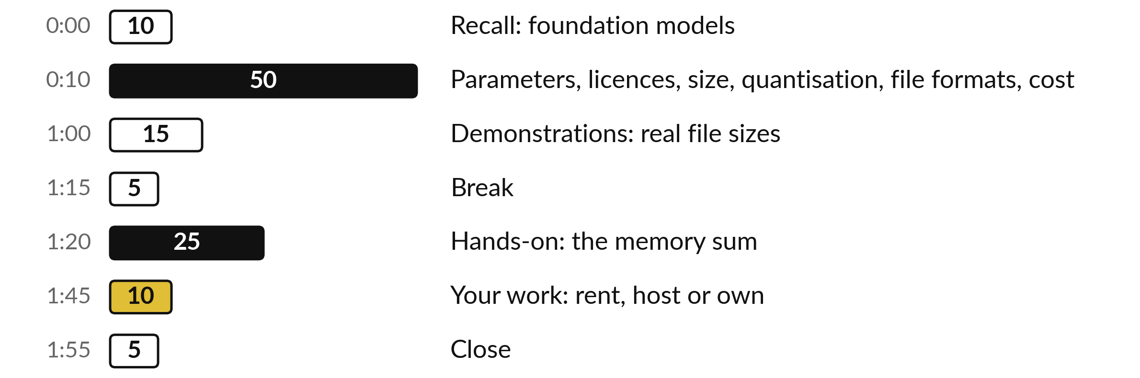
Your two hours: numbers first, then the decision
You do the memory sum by hand and fill the decision sheet yourself.
Notes:
To get you there, today has three big parts. First, fifty minutes on the ideas, each built from numbers you can check with a pen: what is inside a model file, who may use it, how its size comes from a multiplication, how quantisation shrinks it, why a file format is a separate thing, and when hosting pays.
Then fifteen minutes of demonstrations with real file sizes that I measured. After the break you work the memory sum on paper and fill a rent, host or own sheet for a task of your own.

Slide 4

Three questions from last time
1. What is the difference between pretraining and post-training?
2. What can a benchmark tell you about a model, and what can it not tell you?
3. Name two things you can read on a model card.
Answer aloud first. Then we check together.
Notes:
Three quick questions from Session 6. Answer aloud first, and then we check together. It is a warm-up to bring last time back.
Question one. What is the difference between pretraining and post-training? Take a moment.
A good answer is this. Pretraining is next-token prediction on a huge text corpus, measured by the average loss. Post-training (supervised fine-tuning on written answers, then preference tuning such as RLHF on compared answers) teaches the model to follow instructions.
Question two. What can a benchmark tell you about a model, and what can it not tell you? Say it to yourself first.
A good answer is this. Accuracy on a fixed set of questions with a given setup. Contamination and different settings can mislead, and it does not test your own documents, so you test finalists on your own cases.
Question three. Name two things you can read on a model card. Think about your own work as you answer.
A good answer is this. Its licence, its size in parameters, its context window, its training stages and, if the maker wrote one, its limits.
If an answer was missing, last session’s take-away sheet or workbook page has it. Now to today.

Slide 5
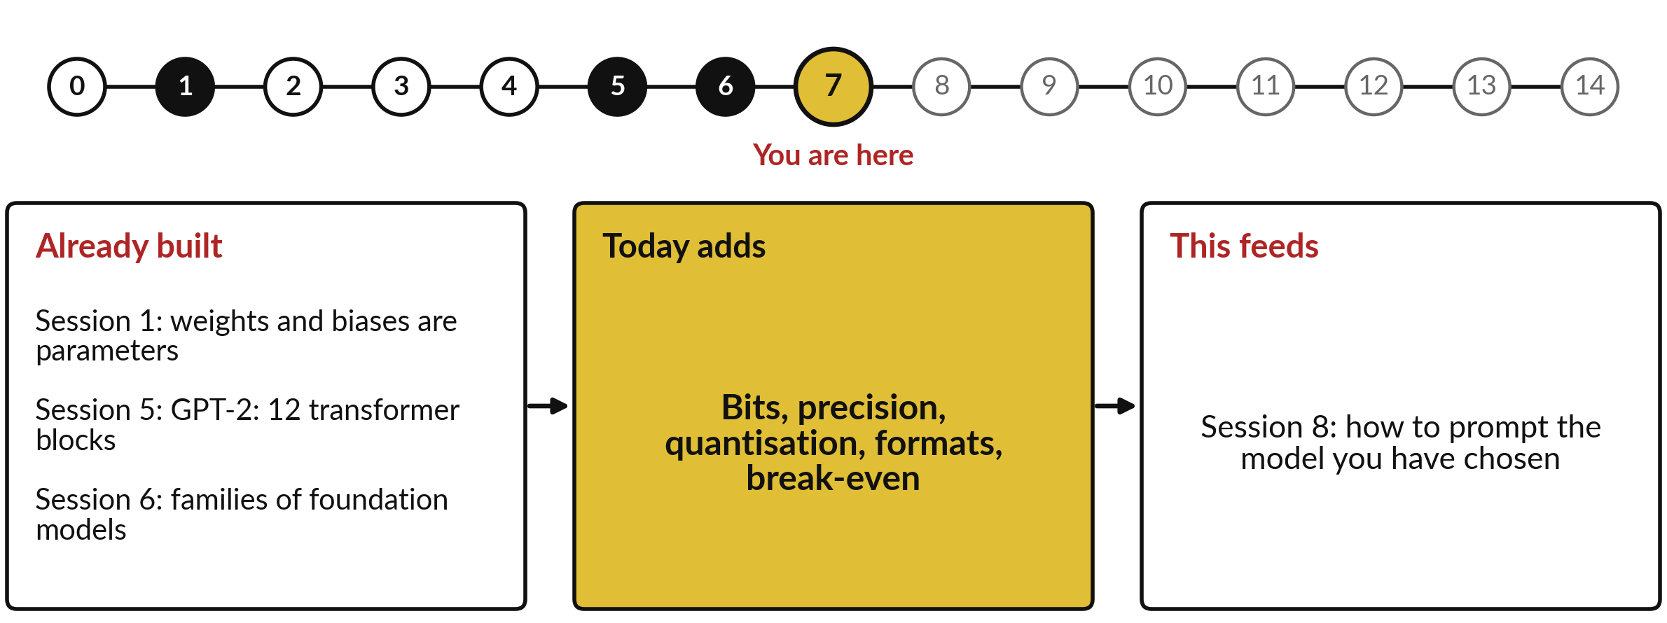
How today connects: what we
already have and what it feeds
Each session is built on the ones before it.
Notes:
So where does today sit in the story? The dots along the top are the fifteen sessions, from the map at Session 0 to your plan at Session 14, and the gold one is today.
We already hold weights and biases are parameters from Session 1, GPT-2: 12 transformer blocks from Session 5 and families of foundation models from Session 6. Nothing today starts from zero.
What today adds is this: bits, precision, quantisation, formats, break-even.
And it feeds straight into what comes next. Session 8: how to prompt the model you have chosen. Keep that chain in mind, because each idea you learn today is a step on it.

Slide 6




Words we use today
Word | What it means
Parameters | All the weights and biases of a model, the numbers training adjusts. GPT-2 small has 124,439,808.
Bit, byte, precision | A bit is a 0 or a 1; 8 bits make a byte. Precision is how many bits each parameter is stored in: FP32, FP16, INT8, 4-bit.
Quantisation | Storing each parameter with fewer bits, by rounding it to one of fewer levels, so the file shrinks.
File format | The container that packs the parameters into a file: Safetensors, GGUF or ONNX. It does not set the precision.
Open weights | The trained parameters can be downloaded, under a licence that can still limit use. Open source (OSI) needs more.
Notes:
Five words for today. I give the plain meaning of each, and we use every one of them before the end of the session.
Parameters. All the weights and biases of a model, the numbers training adjusts. GPT-2 small has 124,439,808.
Bit, byte, precision. A bit is a 0 or a 1; 8 bits make a byte. Precision is how many bits each parameter is stored in: FP32, FP16, INT8, 4-bit.
Quantisation. Storing each parameter with fewer bits, by rounding it to one of fewer levels, so the file shrinks.
File format. The container that packs the parameters into a file: Safetensors, GGUF or ONNX. It does not set the precision.
Open weights. The trained parameters can be downloaded, under a licence that can still limit use. Open source (OSI) needs more.
Keep those words close. The first idea uses them straight away, so let us begin.

Slide 7
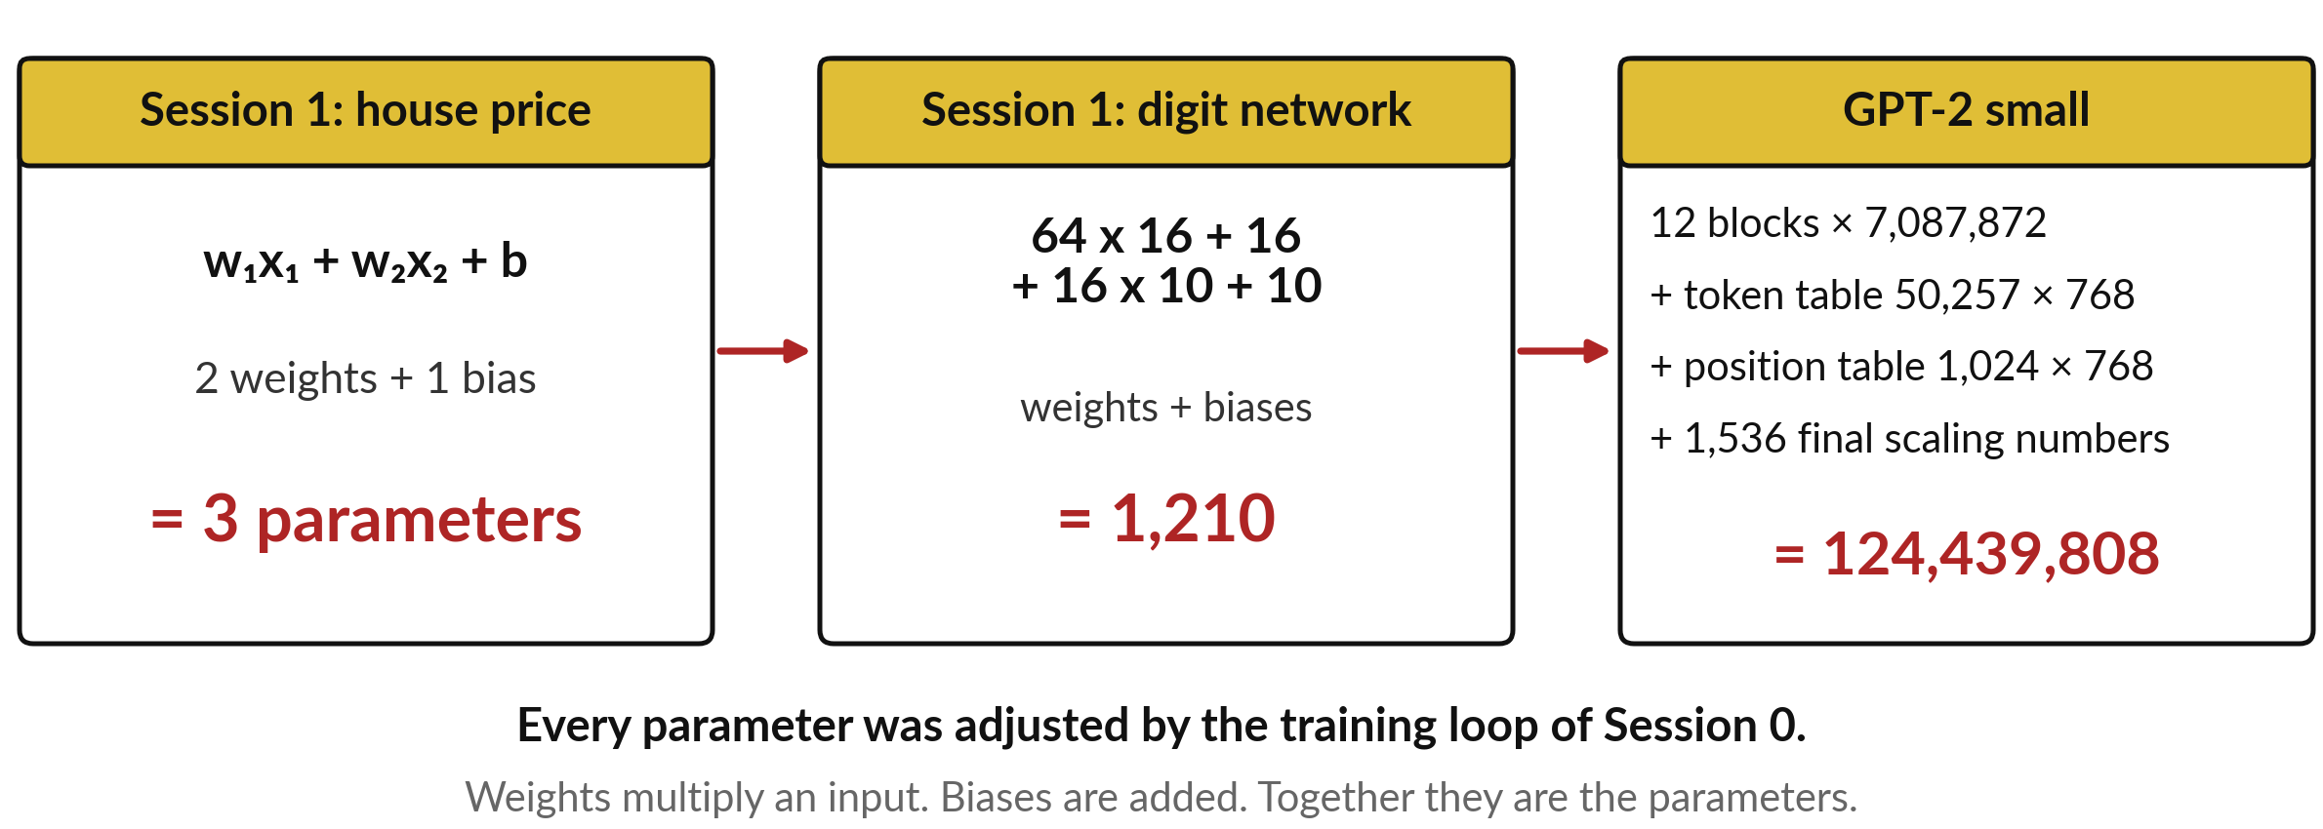
Parameters are the weights and biases of
Session 1: GPT-2 small has 124,439,808 of them
Parameters = weights + biases. GPT-2 count from demo_runs/s07/gpt2_count.py.
Notes:
Today one word comes up all the time, so let me build it from what you know. In Session 1 the house price was a weighted sum: w one times x one, plus w two times x two, plus b. Each w is a weight, which says how much one input counts, and b is the bias, a number added to the sum.
Two weights and one bias make three parameters. The digit network had 1,210. GPT-2 small, from Session 5, is the same kind of number, counted on a larger model: 12 transformer blocks of 7,087,872 each, a token table of 50,257 tokens times 768 numbers, a position table of 1,024 positions times 768, and 1,536 final scaling numbers.
Add them and you get 124,439,808, the 124 million you heard in Session 6. Where do those numbers live?

Slide 8
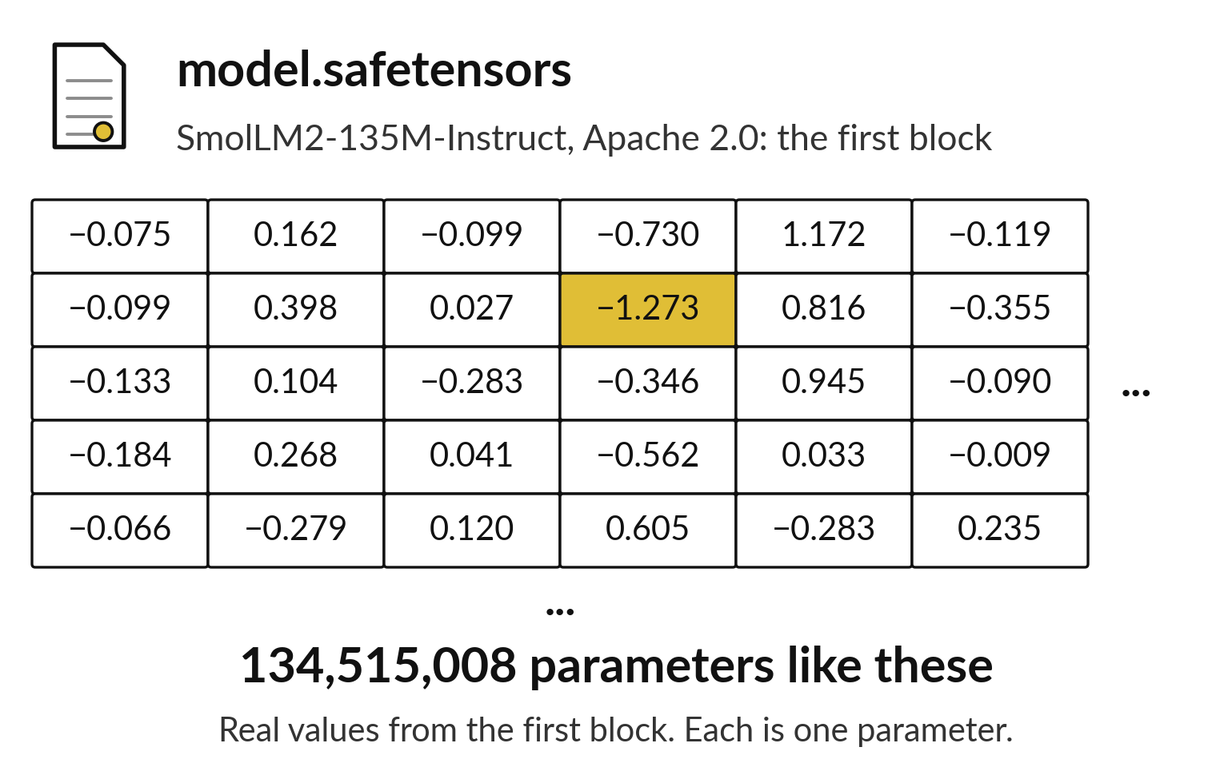
A model file is a long table of
these parameters, and nothing else
Each number in the file is one parameter that training adjusted.
These are real values from the first block of a small open model.
SmolLM2-135M has 134,515,008 parameters.
No words or documents are stored in the file.
Notes:
They live in a file, and this grid is a real piece of one. I read these values from the first block of a small open model called SmolLM2, with 135 million parameters. Each number is a weight of the kind you met in Session 1, and the training loop of Session 0 moved every one a little at a time.
As an analogy, picture a mixing desk with 134 million sliders: the file is the list of where each slider ended. Counting weights and biases together gives 134,515,008 parameters. The file holds no words and no documents, only these numbers. So two questions follow: who may use such a file, and how big is it? Let us take who may use it first.

Slide 9
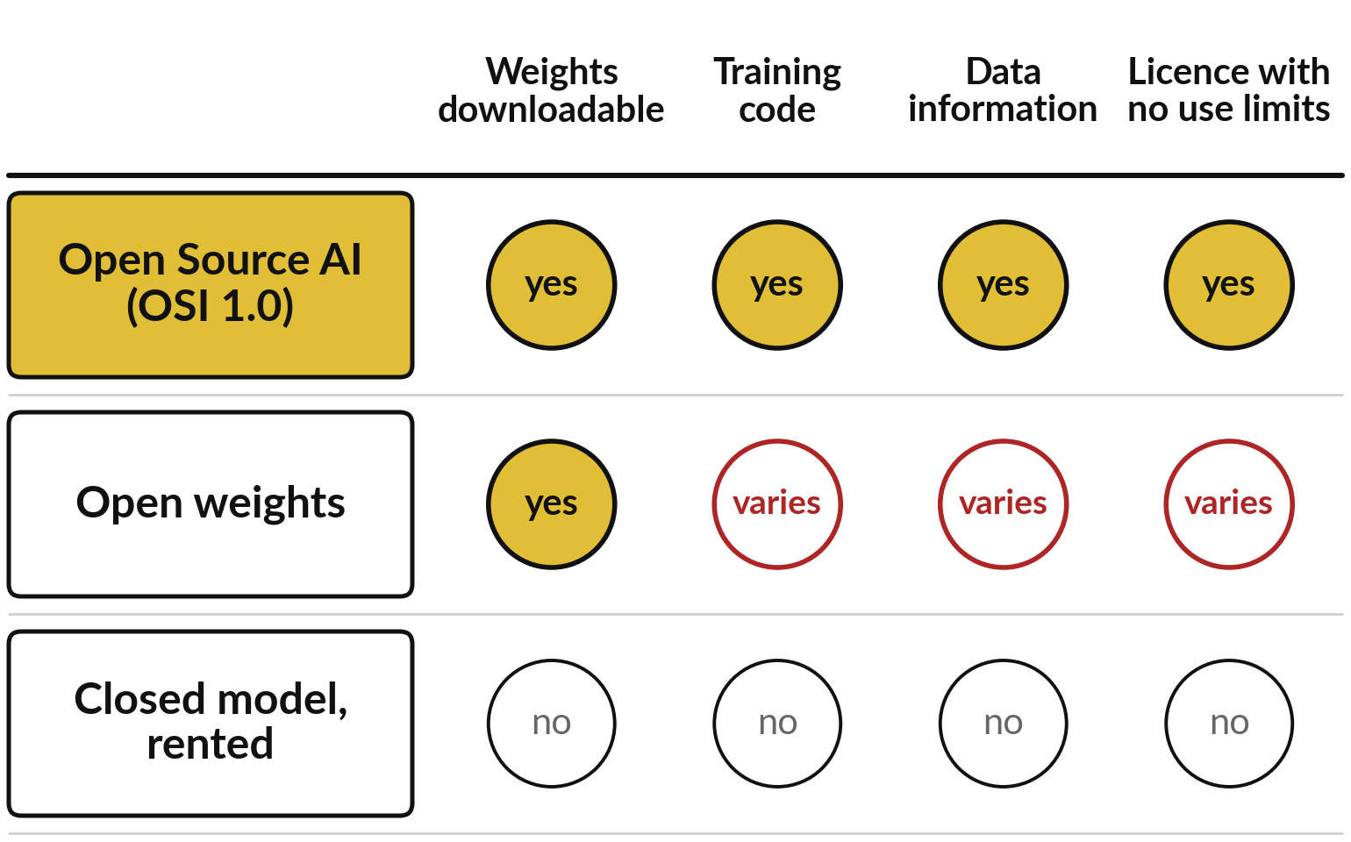
Open weights means the parameters can
be downloaded; open source needs more
The Open Source Initiative (OSI) definition of Open Source AI needs all four.
Open weights: the file can be downloaded. The licence can still limit use.
OSI Open Source AI Definition 1.0, 2024. Data information describes the training data; the data itself need not be shared.
Notes:
Session 0 set open weights against a rented model, and Session 6 used the term; now we make it precise. A licence is the legal permission that says what you may do with a model. Open weights means the parameter file can be downloaded and run, under a licence that may still limit use.
Open source in the sense of the Open Source Initiative, the OSI, is stricter. Think of a cake, as an analogy: open weights is the finished cake you may take home, and open source is the cake, the recipe and the shopping list, with permission to bake it for any purpose.
The OSI definition asks for the parameters, the complete code to train and run the system, enough information about the training data, and a licence with no use limits. Most downloadable models give you the first item only.

Slide 10
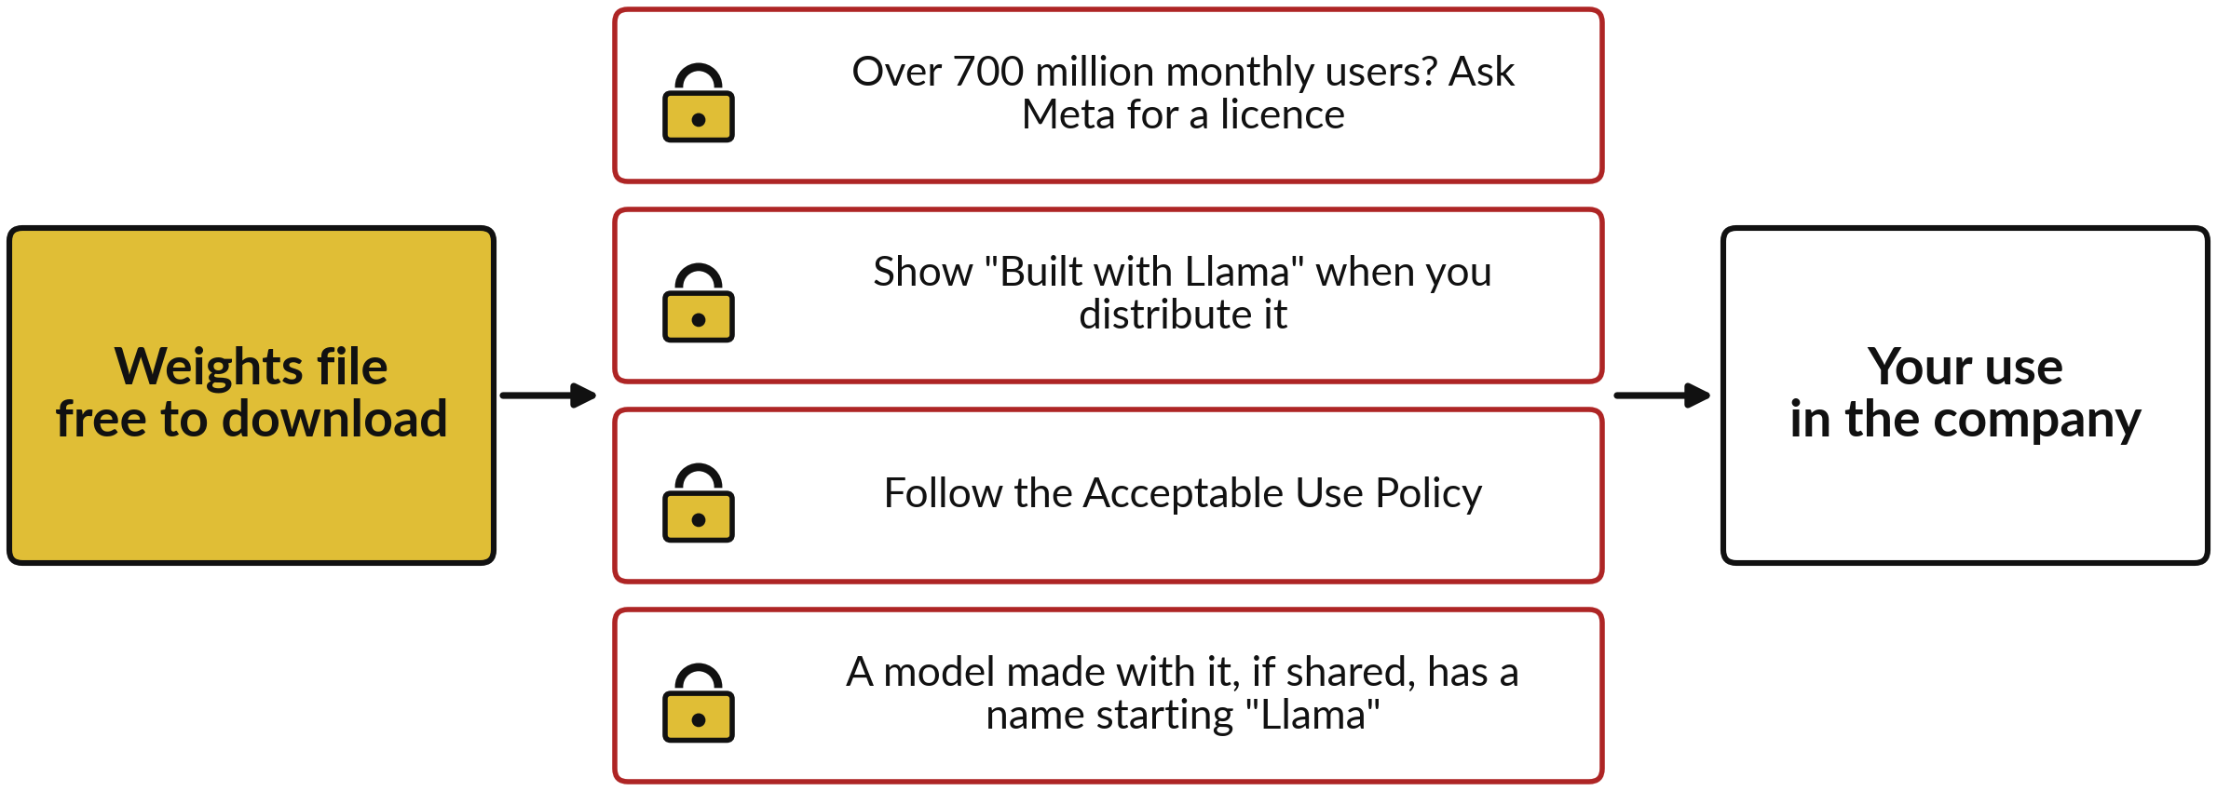
A licence with conditions makes a model
open weights, however free the download
Llama 3.2 licence, read on 6 November 2026. Check the version in force.
Notes:
Even that first item can come with strings attached, so here is a real example. Meta lets you download its Llama parameters for free. The Llama 3.2 licence still has conditions. A company with more than 700 million monthly users must ask Meta for a licence. You must show Built with Llama if you distribute it, and follow the Acceptable Use Policy, Meta’s list of uses that are not allowed. A model made with it and shared must have a name starting with Llama.
The Open Source Initiative said in 2023 that the Llama licence is not open source because it limits some users and some uses, and repeated this in February 2025 for Llama 3.x. So call such models open weights. This is not legal advice, so read the licence you will use. Now to the second question, size.

Slide 11
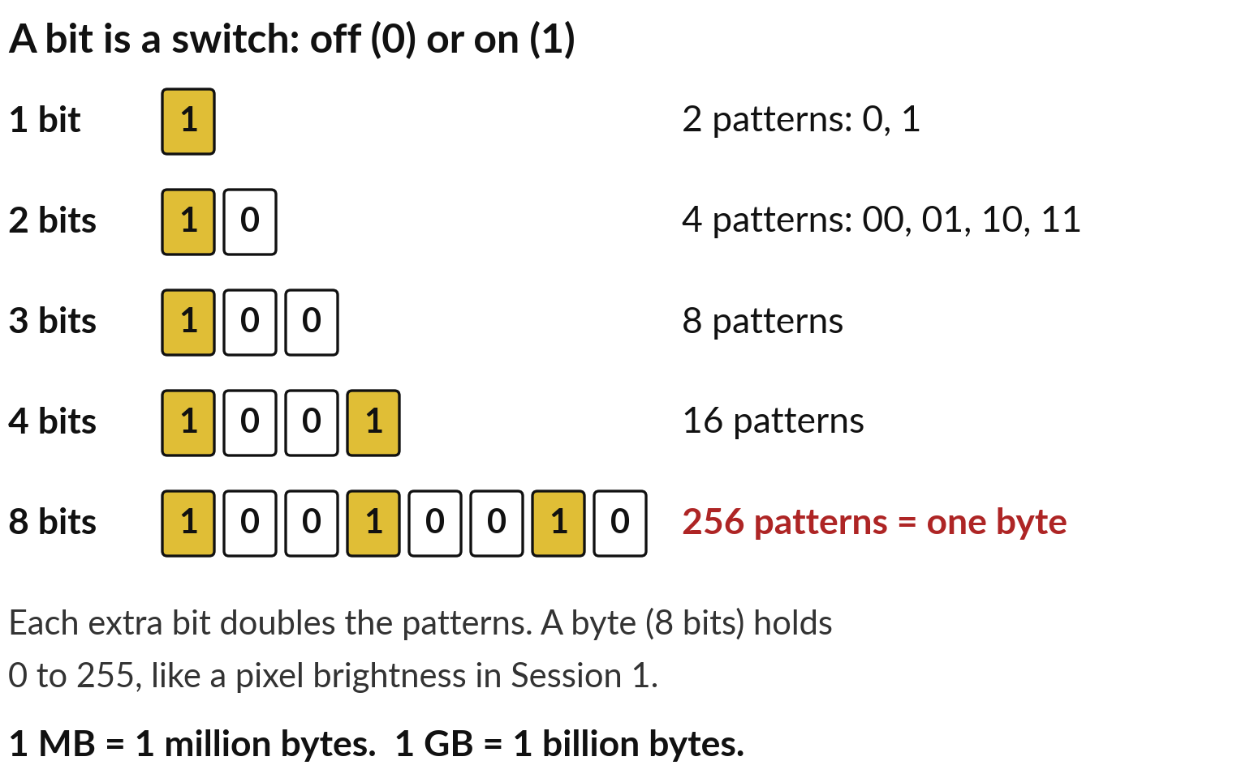
To measure size, start with bits and bytes:
8 bits make a byte with 256 patterns
A bit is the smallest unit of storage: a 0 or a 1. Each extra bit doubles the patterns.
4 bits: 16 patterns. 8 bits, one byte: 256 patterns.
A byte holds a whole number from 0 to 255, as a pixel did in Session 1.
1 MB is a million bytes; 1 GB is a billion bytes.
Notes:
File size is measured in bytes, so we build the byte first. A computer stores everything as switches that are off or on, written 0 or 1. One switch is a bit, and it has two patterns. Two bits have four patterns: 00, 01, 10 and 11. Each extra bit doubles the count, so three bits give 8, four bits give 16, and eight bits give 256.
Eight bits together are called a byte, so one byte can hold any whole number from 0 to 255. That is exactly the brightness range of a pixel in Session 1. A megabyte, MB, is a million bytes, and a gigabyte, GB, a billion. Keep two numbers in mind for later: 4 bits give 16 patterns, 8 bits give 256. Now let us size some familiar files.

Slide 12
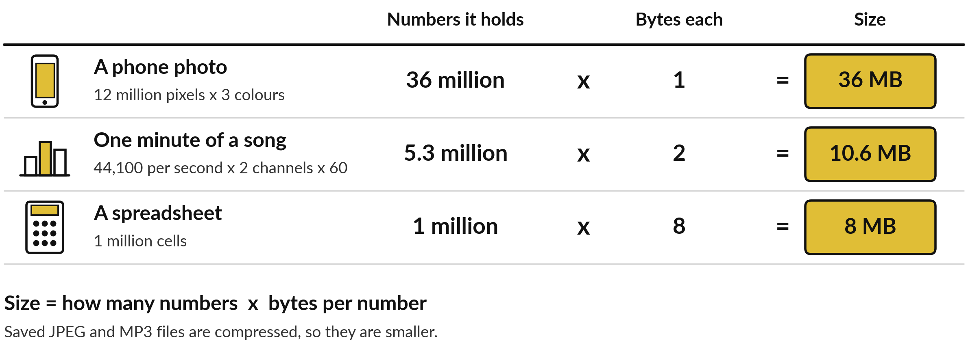
Any file is how many numbers it holds
times the bytes each number takes
Size = numbers × bytes per number. Compressed files (JPEG, MP3) are smaller.
Notes:
With bytes in hand, every file on your phone is one multiplication. A photo of 12 million pixels has three numbers per pixel, red, green and blue, at one byte each: 36 million bytes, so 36 megabytes. One minute of CD-quality music holds 44,100 numbers a second on each of two channels, about 5.3 million numbers, at two bytes each: 10.6 megabytes.
A spreadsheet of a million numbers stored at eight bytes each is 8 megabytes. A saved JPEG or MP3 is smaller because it is compressed, squeezed by spotting repeated patterns. Notice the middle column: the more bytes each number takes, the bigger the file, and the finer the detail it keeps.
For a model, how many bytes does each parameter take?

Slide 13
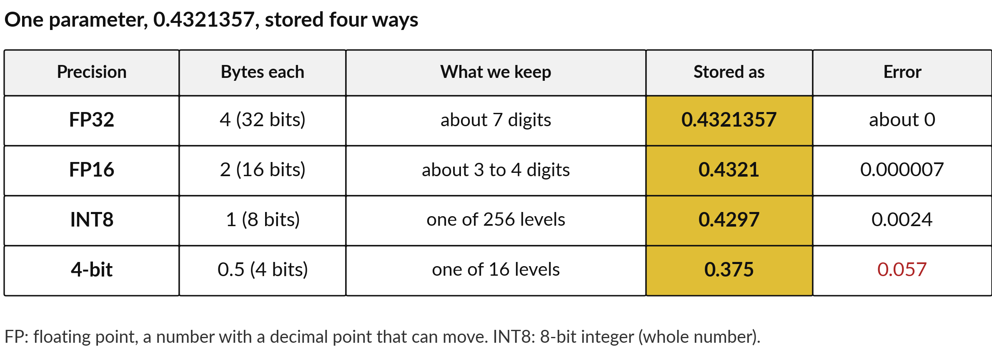
Precision is how many digits we keep for
each parameter: FP32, FP16, INT8 and 4-bit
Fewer bits per parameter: fewer digits kept, a smaller file, a bigger error.
Notes:
It depends on the precision, which is how many bits each parameter is stored in, and in plain words, how many digits we keep. Take one parameter, 0.4321357. FP32, 32-bit floating point, uses four bytes and keeps about seven digits, so it stores the number almost exactly. Floating point means a number with a decimal point that can move.
FP16 uses two bytes and keeps about three to four digits: 0.4321. INT8, an 8-bit integer, uses one byte, so it can only pick one of 256 levels: here 0.4297, an error of about 0.0024. Four bits is half a byte and only 16 levels: 0.375, an error of 0.057.
Fewer bits mean a smaller file and a bigger error. Now we can size a model.

Slide 14
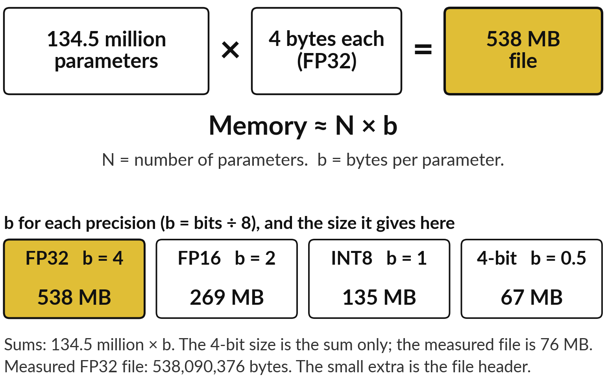
Model memory = parameters
× bytes per parameter
134.5 million parameters times 4 bytes each is 538 MB.
In symbols: memory ≈ N × b. N: parameters. b: bytes per parameter.
b = bits ÷ 8: FP32 4, FP16 2, INT8 1, 4-bit 0.5.
GPT-2: 124,439,808 × 4 bytes ≈ 498 MB.
Notes:
It is the photo sum again. Count the parameters, multiply by the bytes each one takes, and you have the size of the weights. In symbols, memory is approximately N times b, where N is the number of parameters and b is the bytes per parameter, the bits divided by eight.
For our small model at FP32: 134.5 million times four is about 538 million bytes, 538 megabytes. I wrote the real file and measured it: 538,090,376 bytes, the small extra being the file header, a short label section at the start. At FP16 it halves to 269, at INT8 135, at 4-bit about 67.
For GPT-2, 124,439,808 times four is about 498 megabytes. The approximately sign is there because files carry a little extra. Let us push the same sum to big models.

Slide 15
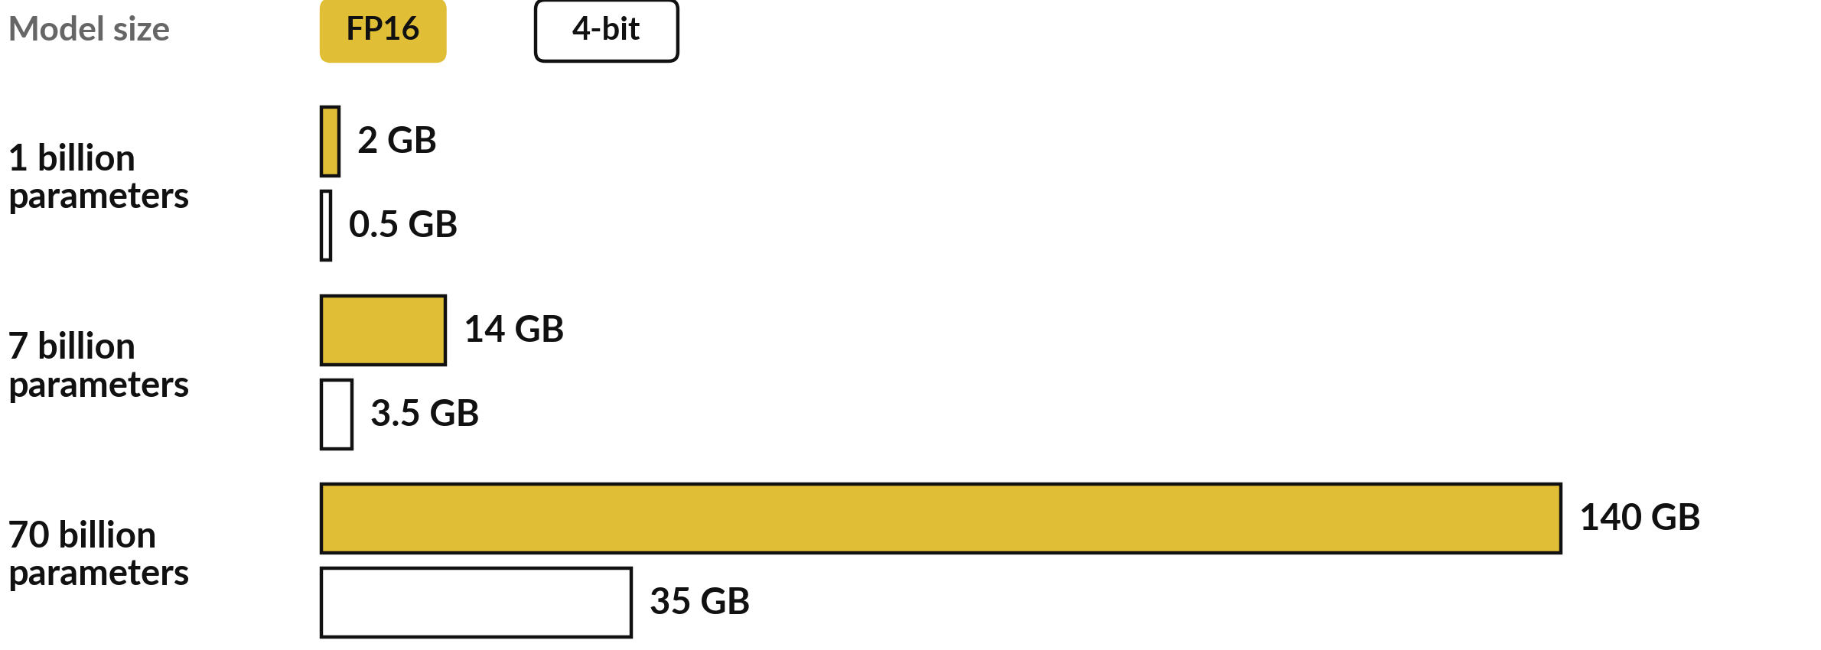
The same sum shows why big
models need big machines
Memory ≈ N × b, weights only: b = 2 bytes (FP16) or 0.5 byte (4-bit). Arithmetic only.
Notes:
This is where the same multiplication, N times b, gets uncomfortable for a laptop. One billion parameters at two bytes each, in FP16, is two gigabytes. Seven billion is fourteen. Seventy billion is one hundred and forty gigabytes, which no ordinary laptop holds. Halve the bytes and you halve the memory, and four bits is half a byte, so seventy billion shrinks to thirty-five gigabytes.
This is the arithmetic of the weights alone. Running a trained model to get an answer is called inference, and it needs working memory for your conversation on top, so real needs are higher. Do not trust any claim about running a model on a given machine until the sum has been done. But how is a parameter squeezed into half a byte?

Slide 16
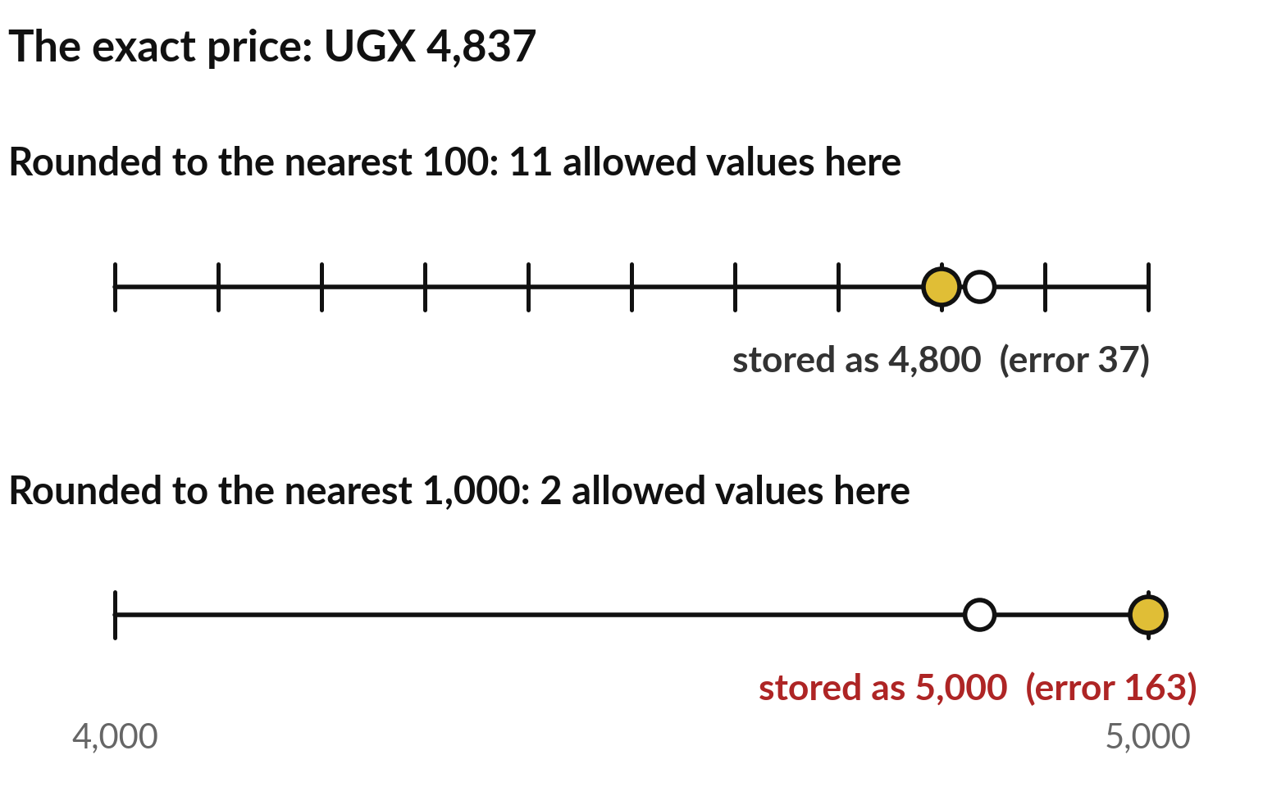
Everyday picture: rounding a price to
the nearest UGX 100 needs fewer digits
An analogy for quantisation: fewer allowed values, a shorter number, a small error.
UGX 4,837 to the nearest 100 is 4,800. The error is 37.
To the nearest 1,000 it is 5,000. Shorter still, and the error is 163.
Notes:
Start with something everyone does. Take a price of UGX 4,837. Round it to the nearest hundred shillings and you write 4,800: eleven possible values between 4,000 and 5,000, and an error of 37. Round it to the nearest thousand and you write 5,000: only two possible values, a shorter number, but an error of 163.
Fewer allowed values mean less to write down, and a bigger error. This is the idea of quantisation, storing each parameter with fewer bits by rounding it to one of fewer levels. The analogy breaks in one place: a model does not round to round numbers. It chooses its own evenly spaced levels, and that takes three steps. Let me do them on three real-looking numbers.

Slide 17
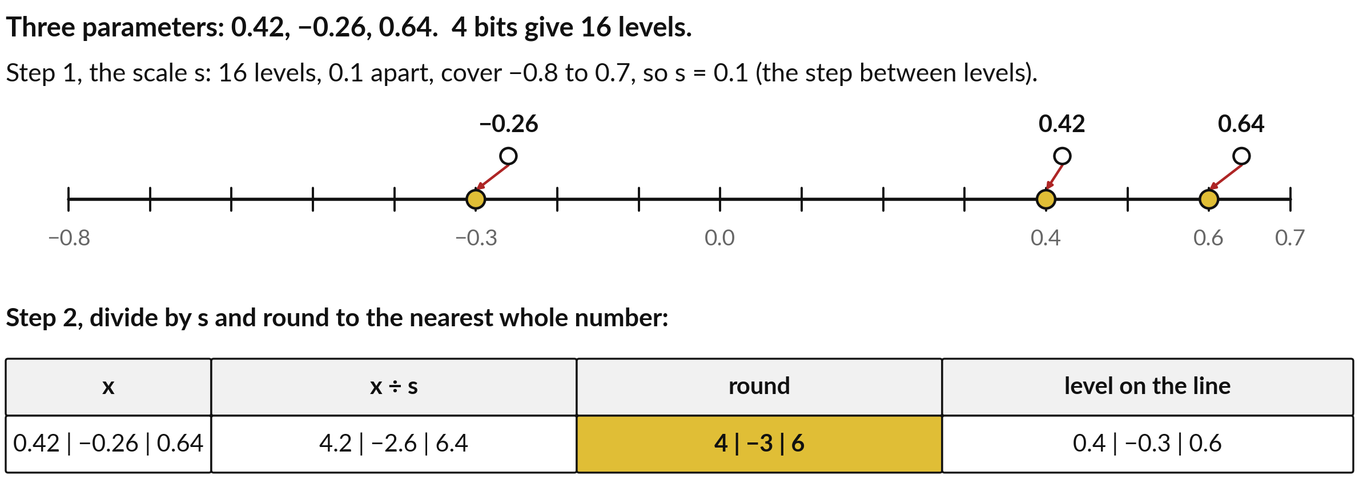
Quantisation, steps 1 and 2: choose
the scale s, then divide and round
s: the step between levels. Rounding snaps each value to the nearest level.
Notes:
Here are three parameters: 0.42, minus 0.26 and 0.64. We want to store each in 4 bits, which, as we saw, gives only 16 patterns, so 16 levels. Step one, the scale, written s: we space the 16 levels evenly, 0.1 apart, so they run from minus 0.8 to 0.7.
The scale is the step between neighbouring levels, so s is 0.1. Step two: divide each value by s and round to the nearest whole number. 0.42 divided by 0.1 is 4.2, which rounds to 4. Minus 0.26 gives minus 2.6, which rounds to minus 3. 0.64 gives 6.4, which rounds to 6.
On the number line, each value has snapped to its nearest level: 0.4, minus 0.3 and 0.6. One problem remains: a minus sign.

Slide 18
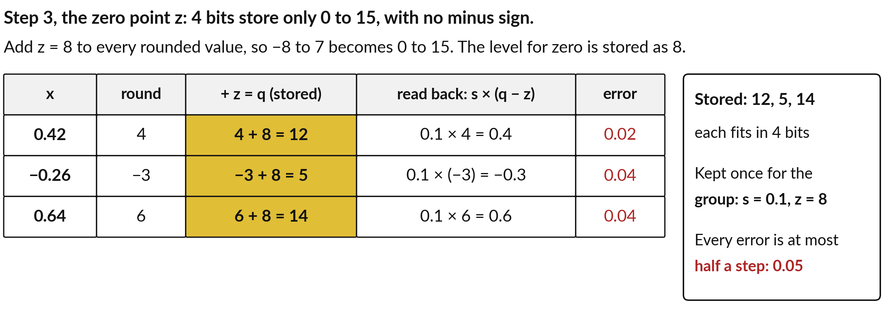
Quantisation, step 3: add a zero point z,
store q, then read back and see the error
q: the whole number stored. s and z are kept once for each small group.
Notes:
Four bits store the patterns 0 to 15 and have no room for a minus sign. So step three adds a fixed number, the zero point, written z, to every rounded value. With z equal to 8, the range minus 8 to 7 becomes 0 to 15, and the level for zero is stored as 8.
Our rounded values 4, minus 3 and 6 become 12, 5 and 14. Those whole numbers, called q, are what the file stores. To read a value back, undo the steps: subtract z, then multiply by s. 12 minus 8 is 4, times 0.1 is 0.4. 5 gives minus 0.3, and 14 gives 0.6.
The errors are 0.02, 0.04 and 0.04, never more than half a step. Now we can write the three steps as one formula.

Slide 19
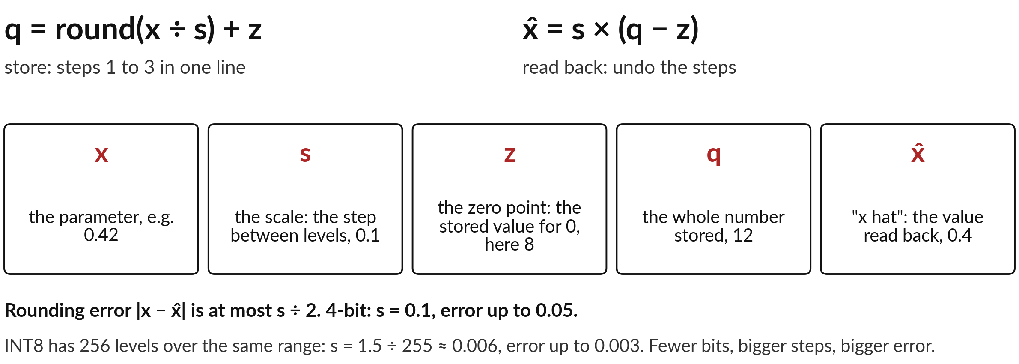
The three steps as one formula: store
the whole number q, then read back x̂
Affine quantisation. Real tools keep one s and z for each small group of parameters.
Notes:
The three steps fit on one line, called affine quantisation in industry. To store: q equals round of x divided by s, plus z. Here x is the parameter, s the scale, z the zero point, and q the whole number stored. To read back: x hat equals s times, q minus z.
X hat, x with a small roof, is the value read back, close to x but rounded. In our example x is 0.42, s is 0.1, z is 8, q is 12 and x hat is 0.4. The rounding error, x minus x hat, ignoring the sign, is at most half a step: 0.05 here.
With 8 bits there are 256 levels over the same range, so the step is about 0.006 and the error at most 0.003. Fewer bits, bigger steps, bigger error. Notice: nothing about file formats.

Slide 20
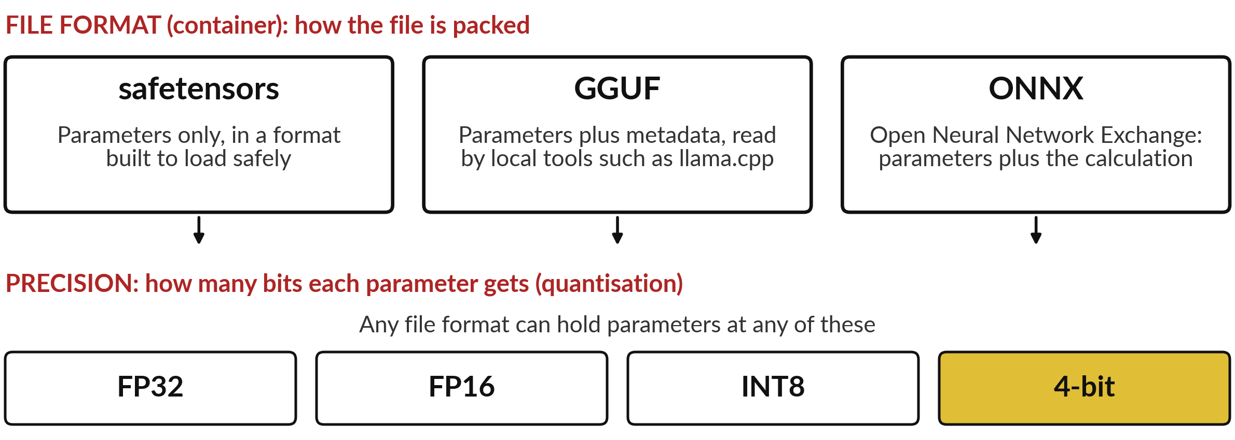
File formats are containers: Safetensors, GGUF
and ONNX. Precision is a separate choice
GGUF is a file format. 4-bit is a precision. A GGUF file can hold either.
Notes:
That matters, because people mix up two separate choices: how many bits each parameter gets, which is quantisation, and which file format packs them. Think of a letter saved as a Word file or as a PDF. The words are the same, and the format is only the container.
The Safetensors format holds just the parameters, in a file built to load safely. GGUF holds the parameters together with metadata, settings such as the vocabulary, in one file, and local tools such as llama.cpp, a free program for running models on a laptop, read it. ONNX, the Open Neural Network Exchange, holds the parameters with the calculation, so a model can move between tools.
A vendor who says we ship GGUF has told you the container and nothing about the size. Let me prove the two are separate.

Slide 21
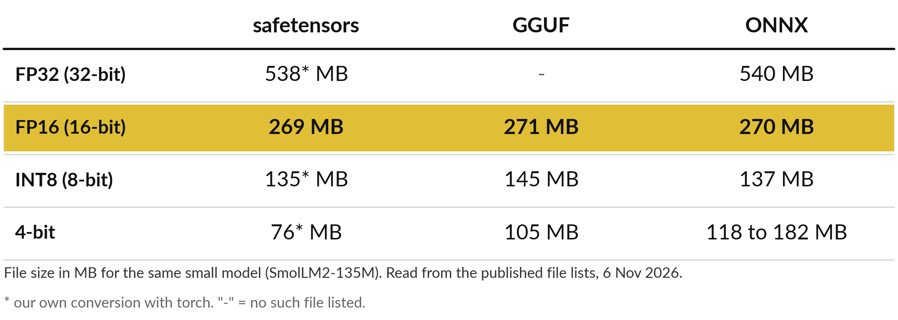
Same model, three file formats:
the size follows the precision
At FP16 all three are about 270 MB. The 4-bit files differ: ask which method.
Notes:
The proof is in real file lists, read from Hugging Face, a website where people share models. This is the same small model in three formats. At FP16 it is about 270 megabytes in all three, just what our sum predicts: 134.5 million times two bytes. At 8 bits it is between 135 and 145. The format did not change the size; the precision did.
At 4 bits the answers differ, from 76 for my own simple conversion to 105 for a GGUF file and up to 182 for one of the ONNX files. Those are different methods, and some keep parts of the model at higher precision. So when someone says 4-bit, ask which method and what the file size is. Next I make the sizes myself.

Slide 22
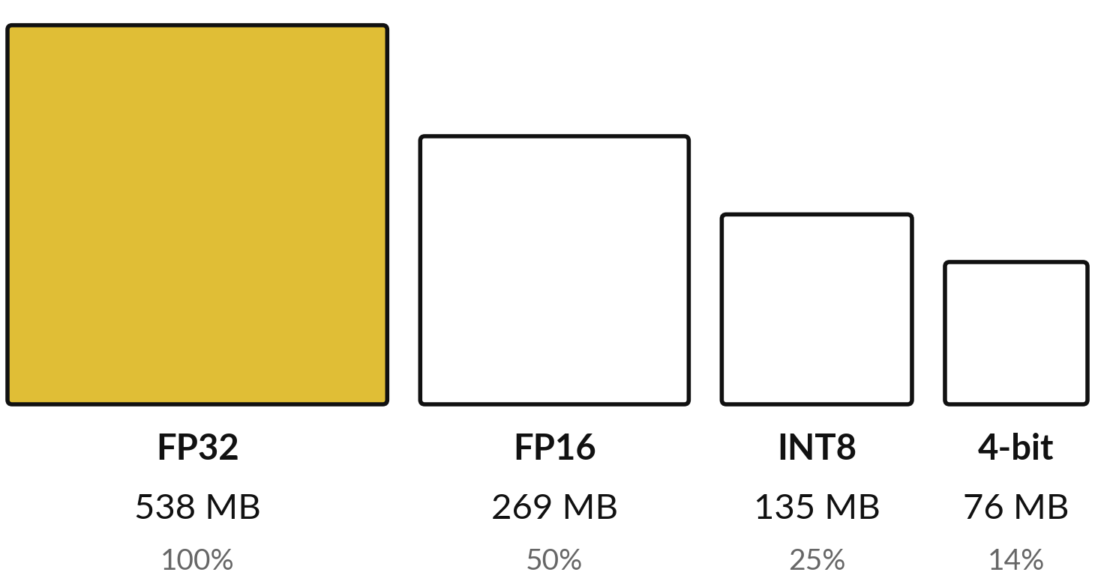
Demonstration 1: one small
model, four precisions, measured
I will show
Watch for
Recorded run, SmolLM2-135M, torch, 6 November 2026.
The areas follow the file sizes.
Four bits would give one eighth. The file is 14%, because the scales add about 8 MB.
Notes:
This is a recorded run, and you can watch me repeat it. Watch two things: the areas of the boxes follow the file sizes, and the last box is not quite what the arithmetic predicts. I loaded the small model, counted its parameters, and saved the same numbers four times: at FP32, FP16, INT8 and 4-bit, with the rounding steps you just did by hand. Then I asked the computer for the size of each file.
538 megabytes, 269, 135 and 76. Each step halves it, until the last one. Four bits should give one eighth, about 67 megabytes. The extra eight is the scale numbers that every small group of 32 parameters carries, so that it can be read back.

Slide 23
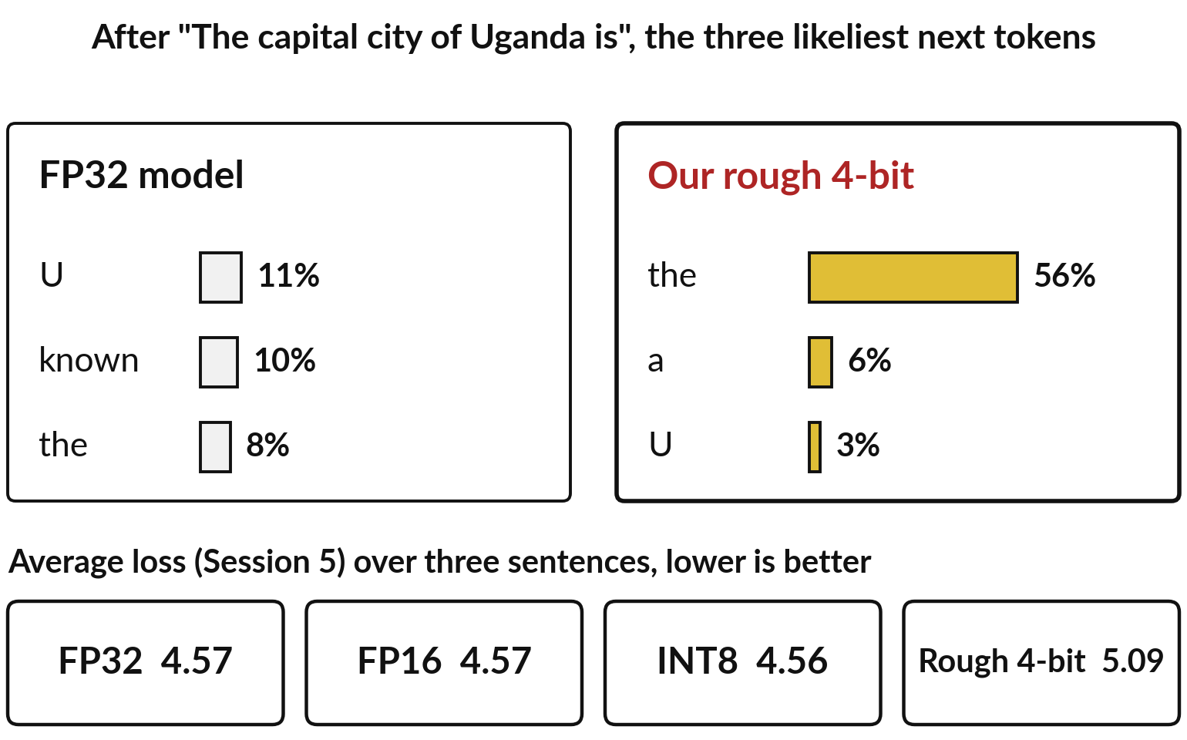
Smaller costs some quality: INT8
barely moved, our rough 4-bit did
Recorded run: the same model, three test sentences.
This is a very small model, and small models lose more when squeezed.
Published 4-bit methods are smarter than my rough one.
Test any shrunk model on your own cases.
Notes:
What did you see in those boxes? The sizes halved with the precision, and the last step was 14 percent, a little over the eighth the sum predicts. A smaller file raises a worry, though: all that rounding error. Does it cost anything?
I measured the average loss on three fixed sentences, the same next-token loss as in Sessions 5 and 6, and the three likeliest tokens after the capital city of Uganda is. At FP16 the results are identical to FP32. At INT8 they barely move. At 4 bits with my rough conversion the loss rises from 4.57 to 5.09 and the top token jumps to the, with 56 percent.
That is a tiny test, and published 4-bit methods keep key parts at higher precision. Test a shrunk model on your own cases.

Slide 24
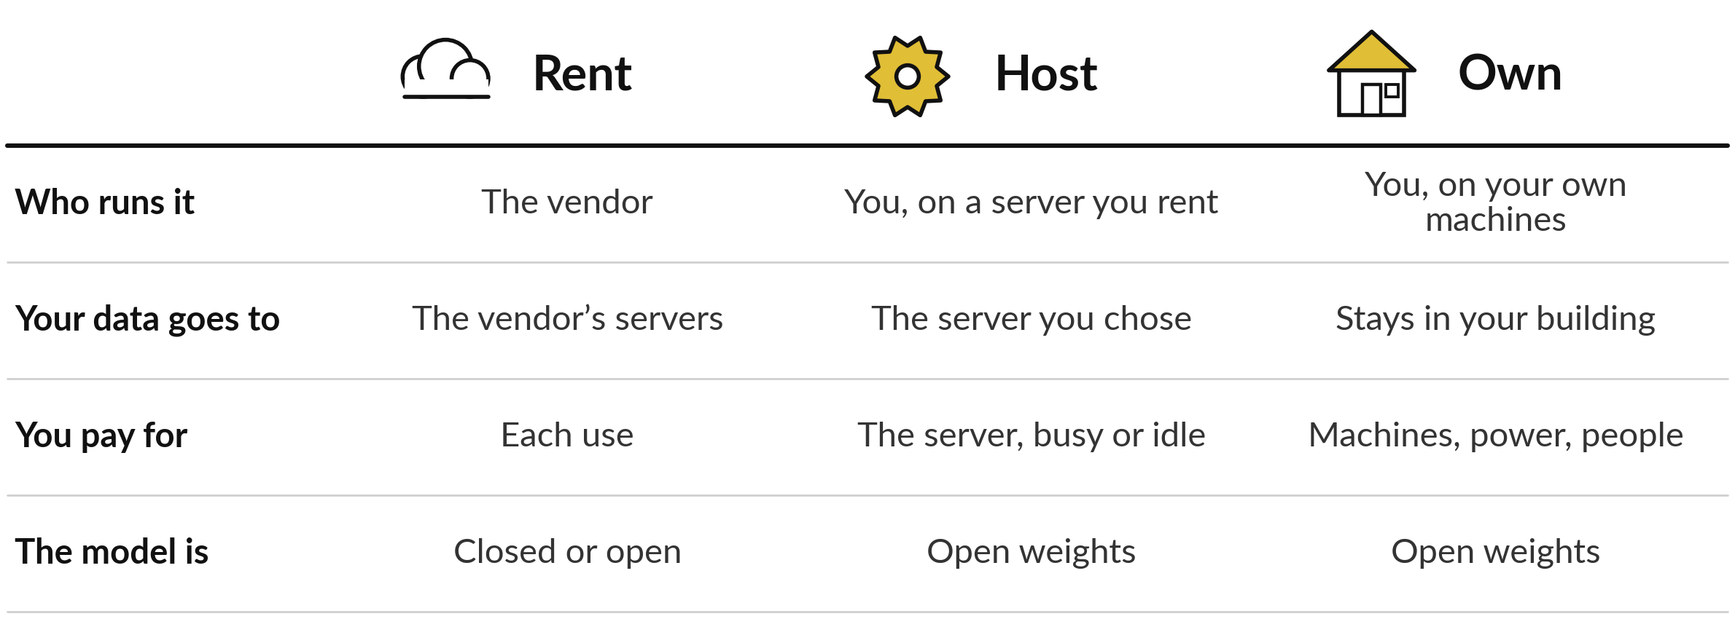
Rent, host or own: who runs the
model and where your data sits
Inference: using the model. Latency: the wait for an answer. Hosting needs open weights.
Notes:
Size and quality tell you what a model needs. The last question is the one Session 0 left for today: cost, who runs the model, and who sees your data. As an analogy, think of getting to a meeting. Renting is taking a taxi, and you pay for each ride. Hosting is hiring a car with a driver by the month, and you pay whether it is busy or idle. Owning is buying the vehicle, and you pay for fuel, repairs and a driver.
For a model, renting means a vendor runs the inference and your data goes to the vendor. Hosting means you run an open weights model on a server you rent, in a place you choose. Owning means your own machines. Latency, the wait for an answer, depends on the hardware in each case. More control needs more skills.

Slide 25
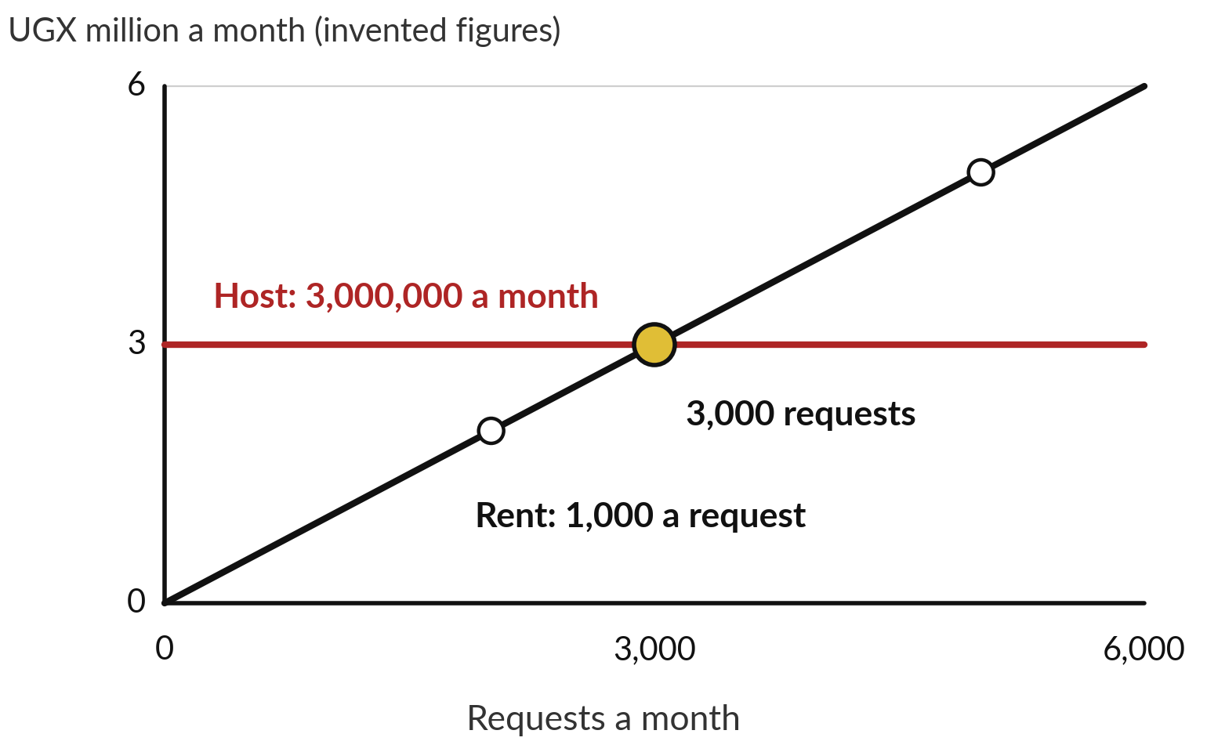
Rent or host? Compare the monthly bills at
a few volumes, and find where they meet
Invented prices: renting costs UGX 1,000 a request; a hosted server costs UGX 3,000,000 a month, busy or idle.
2,000 requests: rent 2,000,000, host 3,000,000.
3,000 requests: both 3,000,000.
5,000 requests: rent 5,000,000, host 3,000,000.
Notes:
A finance manager will ask when control pays for itself, so let us work it out as a story. Nile Valley Foods drafts customer replies with a model. Renting costs UGX 1,000 a request. Hosting means a server at UGX 3,000,000 a month, busy or idle. These prices are invented to show the method, because real prices change often.
At 2,000 requests a month, renting costs 2,000 times 1,000, which is 2,000,000, and hosting 3,000,000: rent wins. At 5,000 requests, renting costs 5,000,000 and hosting still 3,000,000: host wins. They meet where 1,000 times the requests equals 3,000,000, so at 3,000,000 divided by 1,000, which is 3,000 requests.
That meeting point is the break-even volume. Hosting usually has a cost per request too. What then?

Slide 26
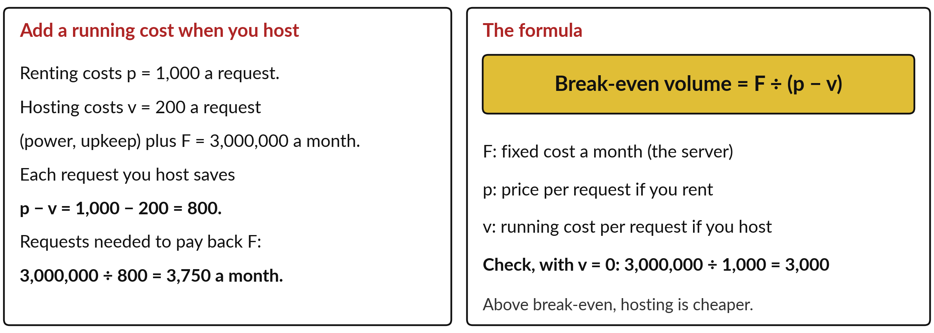
Break-even volume: the fixed cost
divided by what each request saves
Invented prices. Use your own quotes, and add the cost of skills and care.
Notes:
Say each hosted request also costs UGX 200 to run, for power and upkeep. Now each request you host instead of renting saves 1,000 minus 200, which is 800. The server costs 3,000,000 a month, so you need 3,000,000 divided by 800, which is 3,750 requests a month to pay it back.
That is the whole formula. Break-even volume equals F divided by, p minus v. F is the fixed cost a month, the server. p is the price per request if you rent. v is the running cost per request if you host. The bracket p minus v is the saving on each request.
Check it with v equal to zero: 3,000,000 divided by 1,000 gives 3,000, as on the last slide. Above break-even, hosting is cheaper, before you count the people to run it.

Slide 27




NVF would choose a different route for each task
Task | Starting view | Why
Summarise public product reviews | Rent | No private data; pay only for use
Draft replies to customer emails | Rent, after a data-terms check | Customer names and orders leave the company
Read staff payroll and leave files | Host | Sensitive data stays where you choose
Search a large private contract archive | Host | Heavy daily use and confidential papers
A first view only. Confirm with your lawyer and your IT lead, and test before you commit.
Notes:
Let us put the data and the volume together on the company before you try it yourself. Nile Valley Foods, or NVF, sells maize flour, sugar and cooking oil. Here is how it might think through four tasks. Public product reviews carry no private data and come in small numbers, so renting is the simple answer. Customer emails hold names and orders, so rent only after you have read the vendor’s data terms.
Payroll and leave files are the most sensitive, so hosting keeps the data where you choose. A large private contract archive is confidential and searched heavily every day, so it may sit above break-even and hosting may pay. These are first views. Your lawyer and your IT lead should confirm each one.

Slide 28


Four questions expose a
loose use of the word open
Ask the vendor
Listen for
Open source or open weights?
Which licence and limits?
Which file format and precision?
Which hardware?
A licence you can read
A file size and bit count
A test on your own cases
Who updates and secures it
No licence name and no file size means no decision yet.
Notes:
Before you choose a route for your own task, one checklist ties today together, because someone will try to sell you something. Carry it into any vendor meeting. Ask whether the model is open source or open weights. Ask which licence it is under and which uses it limits. Ask which file format and which precision the file uses, because you now know they are separate. Ask which hardware it needs. Then listen.
You want a named licence you can read, a file size and a bit count, a quality test on your own cases, and a clear owner for updates and security. If you hear only the word open, you have no decision yet. Session 13 turns this into the vendor question list. Keep it beside you for the exercise.

Slide 29
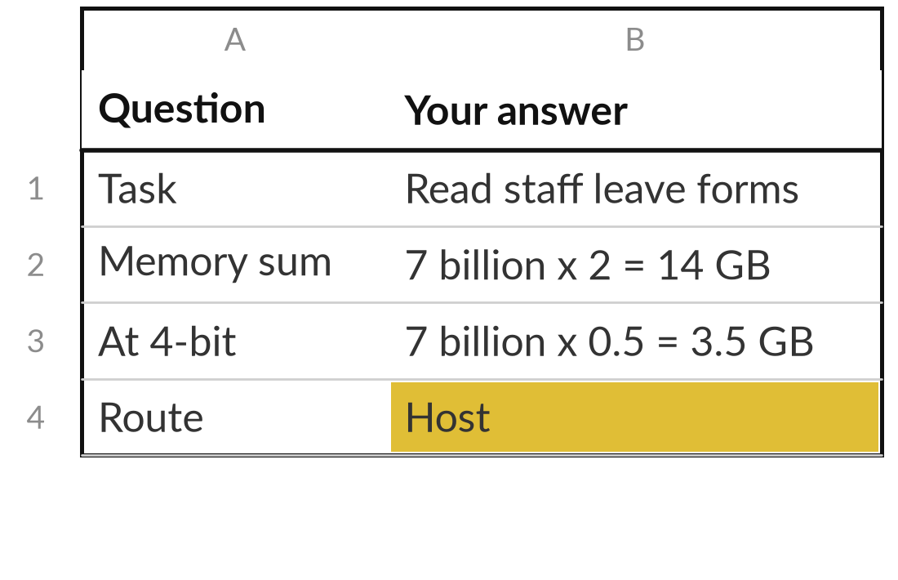
Do the memory sum, then fill your decision sheet
25 minutes
Hands-on, no computer
Size a model by hand, quantise one number, then choose a route for one task.
Take a model with 7 billion parameters.
Use memory ≈ N × b: multiply by 2 bytes (FP16), then by half a byte (4-bit).
Quantise 0.42 with s = 0.1, z = 8: find q and x̂.
Pick one task, name its data, fill the sheet: route, licence question, reason.
You keep: Your rent, host or own sheet with the memory sum filled in.
Notes:
You have the method and the checklist, so it is your turn to use them. This part is on paper, with no computer, and you have twenty-five minutes. First the sum: a model with 7 billion parameters. Multiply by two bytes and write down the size at FP16. Multiply by half a byte and write the size at 4 bits. Then quantise 0.42 with a scale of 0.1 and a zero point of 8: divide, round, add, and read it back.
Then pick one task from your own work, name the data it touches, and fill in the sheet: which route, which licence question you would ask, and your reason in one sentence. If you know your volumes, try the break-even sum too. I will walk round and check the sums.

Slide 30




Which route would you take
for your first model, and why?
Which route fits your first use of a model, given your data, your volume and your skills?
Rent
Host
Own
Wait
A vendor runs it. Quick to start. Read the data terms.
You run open weights on a rented server. More control, more skill.
Your machines, your data. Needs people and upkeep.
Not yet. Fix your data and your use policy first.
Write your route and the one thing that would change your mind.
Notes:
You have filled in the sheet, so here is the decision it was leading to. Which route fits the first model you would use, given your data, your volume and your skills? Rent is the quick start, and you read the data terms. Host gives control, pays above break-even, and needs a person who can run a server. Own gives the most control and needs machines, power and people. Wait is a real answer too, if your data or your use policy is not ready.
Write your route and the single thing that would change your mind. Is it volume, sensitivity of the data, or a licence limit?

Slide 31
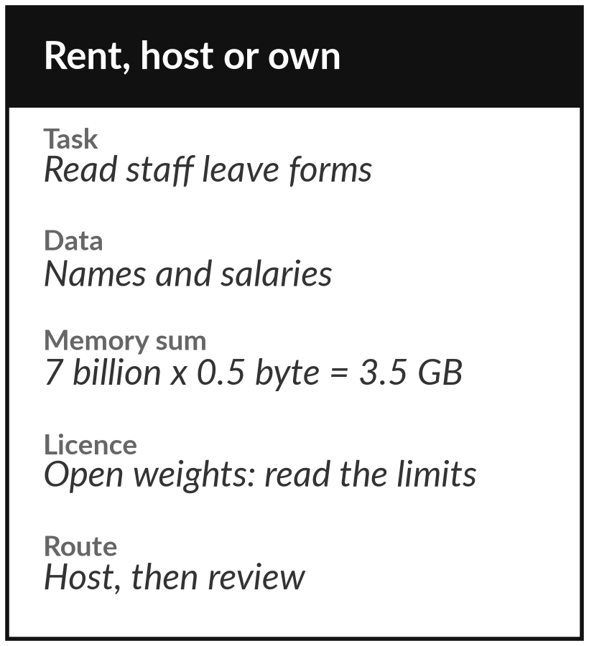
Keep the decision sheet, and ask
the licence questions every time
What you keep from today
A one-page rent, host or own decision sheet, with the memory sum, the break-even sum and the licence questions to ask.
Our question today
What does it mean to own, host or rent a model?
Next session
Session 8: Prompting and reasoning models. Bring one prompt you use often.
Notes:
You have now seen the pieces: the licence, the memory sum, quantisation and the break-even sum. Take the decision sheet with you. It holds the memory sum, the break-even sum, the licence questions and your choice of rent, host or own for one task. Fill it in again for each new use.
Next session is prompting and reasoning models. Bring one prompt you use often, and we will test it together.
We began with this question: What does it mean to own, host or rent a model? Before you go, say in one sentence what you can now say about it.

